Slide 1
Polygon Details

Slide 2
OUTLINE
Rectangle
What is the Polygon?
Polygon Properties
Geometric Drawing Primitives
Polygon face Mode
Discarding Boundary Edges

Slide 3
Rectangle
Rectangle is a polygon.
OpenGL provides a filled-rectangle drawing primitive, glRect
We need 2 points to define one rectangle.
gl. glRect{sifd}( x1, y1, x2, y2);
x1,y1
x2,y2

Slide 4

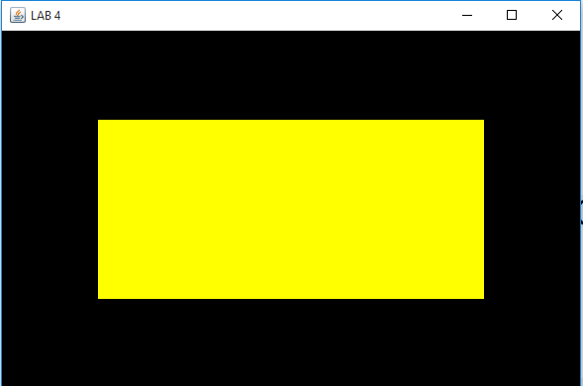
Rectangle ex.
OUTPUT

Slide 5
What is the Polygon?
a polygon is a plane figure specified by a set of three or more coordinate positions, called vertices, that are connected in sequence by straight-Line segments, called the edges or sides of the polygon.

Slide 6
Polygon Properties
A polygon has two sides -front and back.
If vertices of polygons appear in counterclockwise order called front-facing.
Because OpenGL by default use counterclockwise then also we use counterclockwise to draw polygon.
We bracket each set of vertices between a call to glBegin() and a call to glEnd().

Slide 7
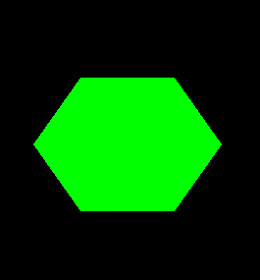
Polygon Ex.
gl.glBegin(GL2.GL_POLYGON);
gl.glVertex2i(-50,75);
gl.glVertex2i(-100,0);
gl.glVertex2i(-50,-75);
gl.glVertex2i(50,-75);
gl.glVertex2i(100,0);
gl.glVertex2i(50,75);
gl.glEnd();
1_V
6_V
2_V
5_V
3_V
4_V
OUTPUT

Slide 8
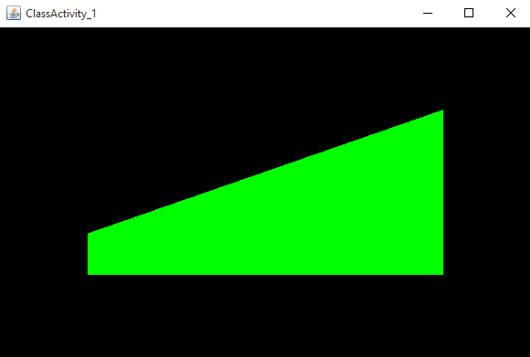
Class Activity

Slide 9
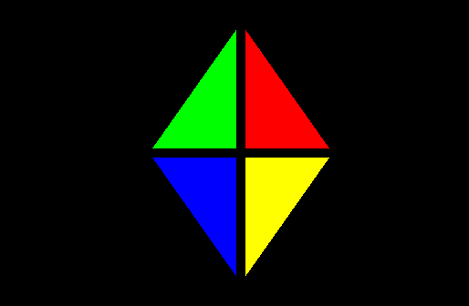
Class Activity

Slide 10
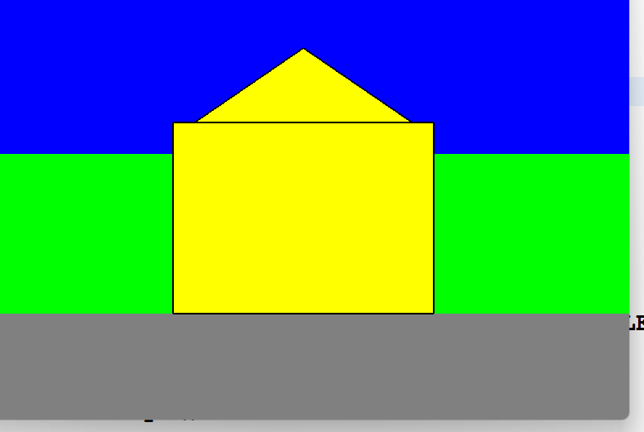
Class Activity

Slide 11
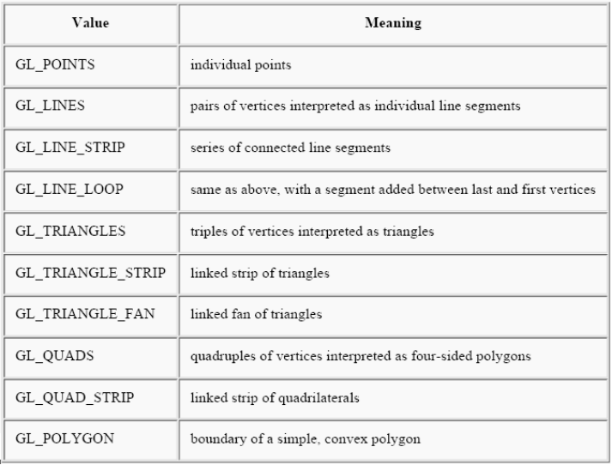
Geometric Drawing Primitives

Slide 12
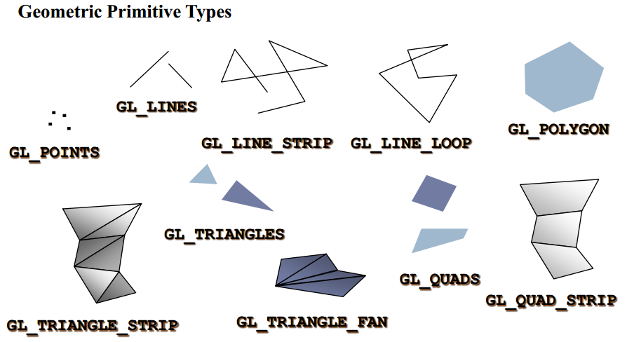
Geometric Drawing Primitives

Slide 13
Polygon face Mode
Each polygon shape contains of two faces, Front and Back.
By default both of them are Fill
The PolygonMode use to control the polygon faces such as (Fill, Line or Point).
Fill Mode
Line Mode
Point Mode

Slide 14
Polygon face Mode
gl.glPolygonMode(GL2.GL_FRONT,GL2.GL_FILL);
gl.glPolygonMode(GL2.GL_BACK,GL2.GL_LINE);
gl.glPolygonMode(GL2.GL_FRONT_AND_BACK, GL2.GL_POINT);
To change the face of polygon form Front to Back or Back to Front we use
gl.glFrontFace(GL2.GL_CW); (ClockWise)
gl.glFrontFace(GL2.GL_CCW); (CounterClockWise)

Slide 15
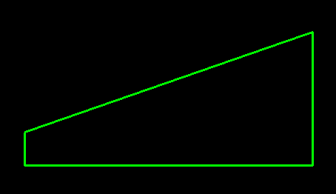
Polygon face Mode Ex.
gl.glPolygonMode(GL2.GL_FRONT,GL2.GL_FILL);
gl.glPolygonMode(GL2.GL_BACK,GL2.GL_LINE);
gl.glFrontFace(GL2.GL_CW);
gl.glBegin(GL2.GL_POLYGON);
gl.glVertex2i(200,100);
gl.glVertex2i(-200,-50);
gl.glVertex2i(-200,-100);
gl.glVertex2i(200,-100);
gl.glEnd();
OUTPUT

Slide 16
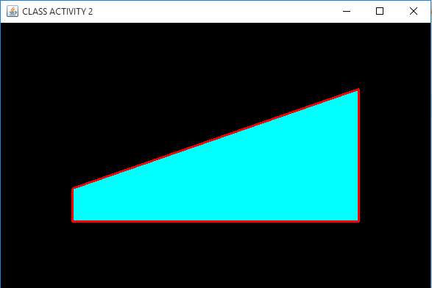
Class Activity

Slide 17
Discarding Boundary Edges
gl.glEdgeFlag(boolean flag) use to discard the boundary edges of polygon, this method only use with LINE mode of polygon.
used between glBegin() and glEnd() .
boolean flag can be true or false if flag is false then all edges after the glEdgeFlag() command is discarded .
When we want to disable discarding edges we change the flag to true.

Slide 18
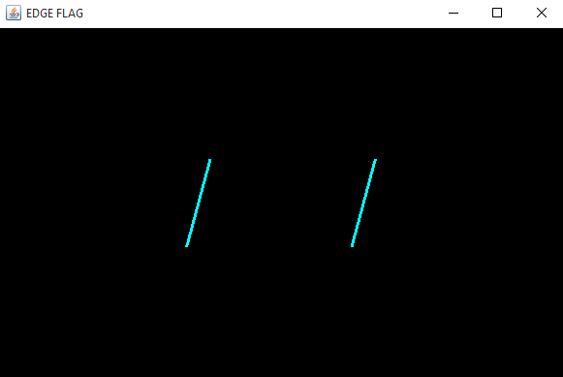
EdgeFlag() Ex.
gl.glPolygonMode(GL2.GL_FRONT,GL2.GL_LINE);
gl.glPolygonMode(GL2.GL_BACK,GL2.GL_FILL);
gl.glFrontFace(GL2.GL_CCW);
gl.glBegin(GL2.GL_POLYGON);
gl.glEdgeFlag(false);
gl.glVertex2i(100,50);
gl.glEdgeFlag(true);
gl.glVertex2i(-75,50);
gl.glEdgeFlag(false);
gl.glVertex2i(-100,-50);
gl.glEdgeFlag(true);
gl.glVertex2i(75,-50);
gl.glEnd();

Slide 19
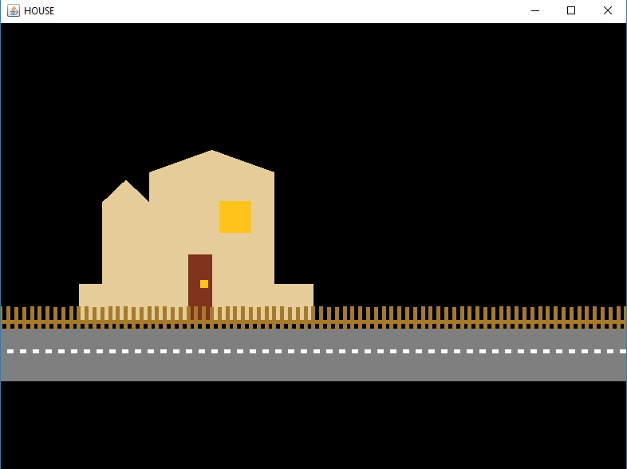
Homework
https://www.rapidtables.com/web/color/RGB_Color.html

